Slide 1

SWIGGY RECOMMEDATION MODEL
Submitted by :
Akhyata Moharana
Amit Porwal
Madhu Gupta
Roshni Patidar
Sourabh Wabale

Slide 2

PRIMARY GOAL
Web Data Extraction: Gather data from a real-time website.
Data Comprehension and Cleaning: Employ Python for understanding and purifying the acquired data.
Visualizing Insights: Utilize Python to create visualizations that expose different data trends.
Machine Learning for Requirement Prediction: Develop a machine learning model to forecast various requirements using the data.

Slide 3
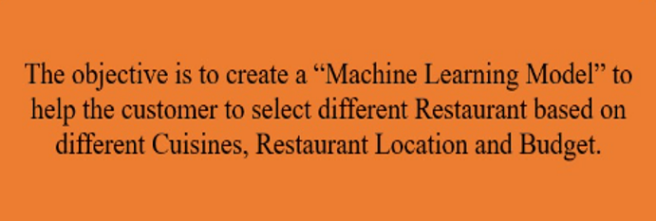
OBJECTIVE

Slide 4






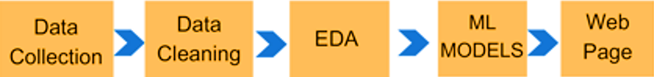
PROJECT EXECUTION ROAD MAP

Slide 5
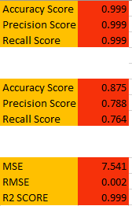
ML MODELS
Linear Regression for Price Prediction
Random Forest Classification for Cuisines Prediction
Random Forest Classification for Location Prediction

Slide 6
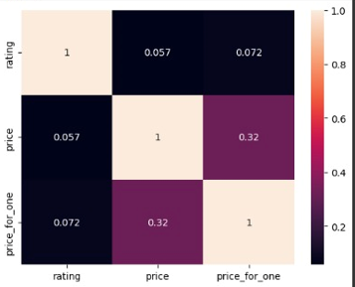

CORRELATION COEFFICIENTS
"No multicollinearity was observed in the data."

Slide 7
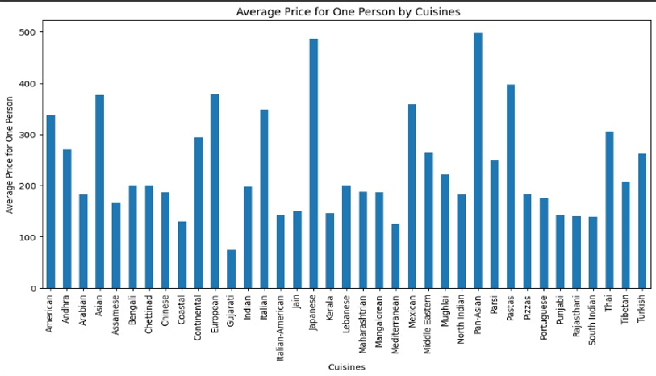

Slide 8
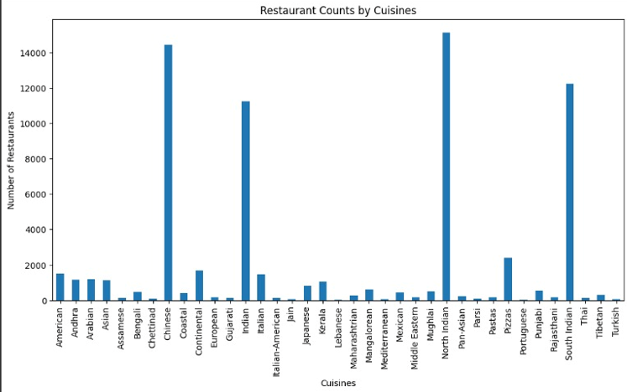

Slide 9
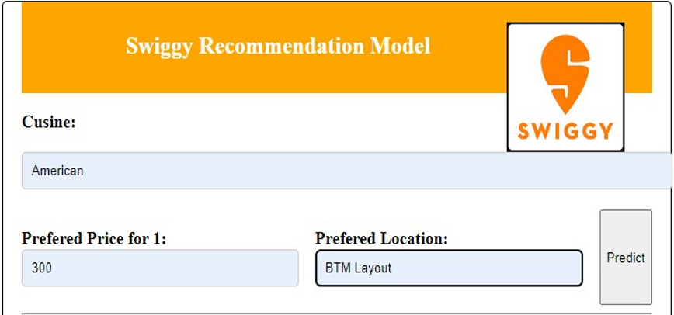
RESULTS

Slide 10
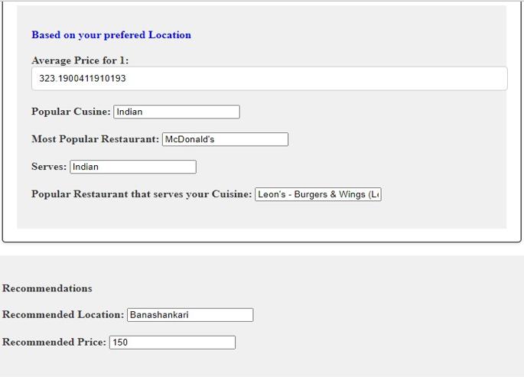

Slide 11

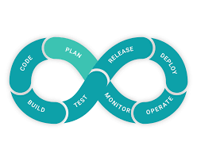

CHALLENGES
Web Scraping Challenges
Selection of ML Model Challenges
Web Page Challenges
Data Retrieval Hurdles
Web Page Structure Volatility
Model Complexity
Data Quality and Quantity
Dynamic Content
HTML Structure Variations

Slide 12
CONCLUSION
Our project has delivered a comprehensive restaurant recommendation model for prospective restaurateurs in Bangalore. It provides insights into popular cuisines, average prices, and top restaurants in chosen areas. Moreover, it offers pricing suggestions and recommends suitable locations based on user preferences. This model is a valuable asset for those entering the restaurant business, guiding them toward well-informed decisions and increased chances of success in the vibrant Bangalore restaurant scene.

Slide 13


